Slide 1
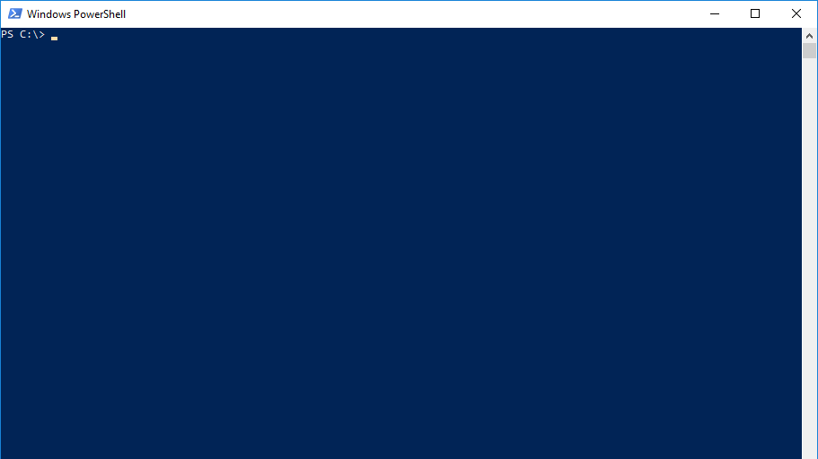
Powershell love C#
By Christoph Ruf

Slide 2
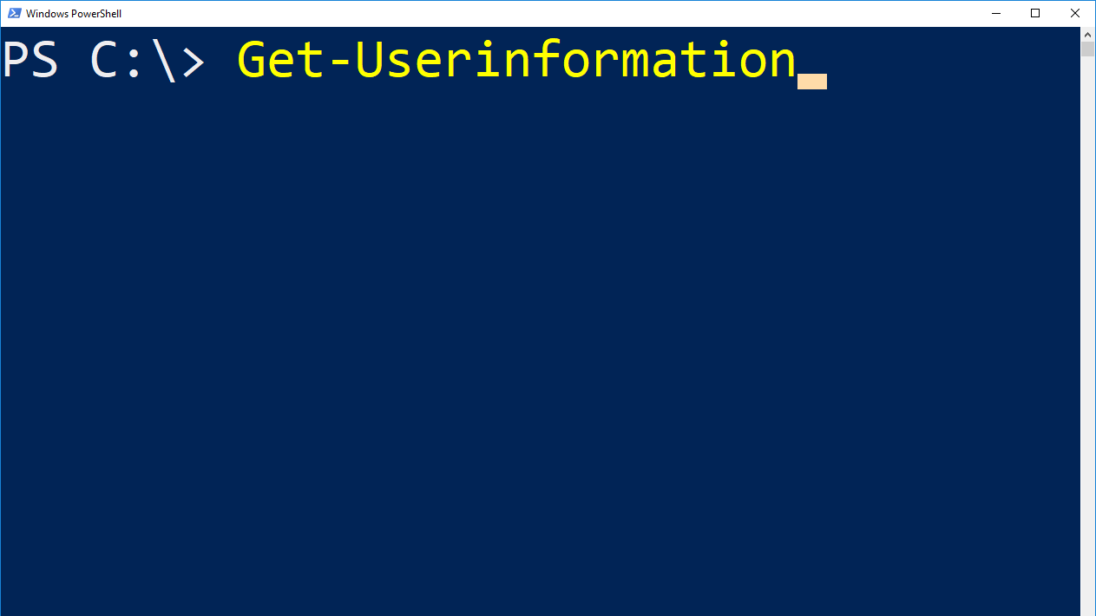
Name: Christoph Ruf
Job: SCCM Specialist, System- and Taskautomation, Client Management, Client Security
Employer: Hirschvogel Holding GmbH

Slide 3
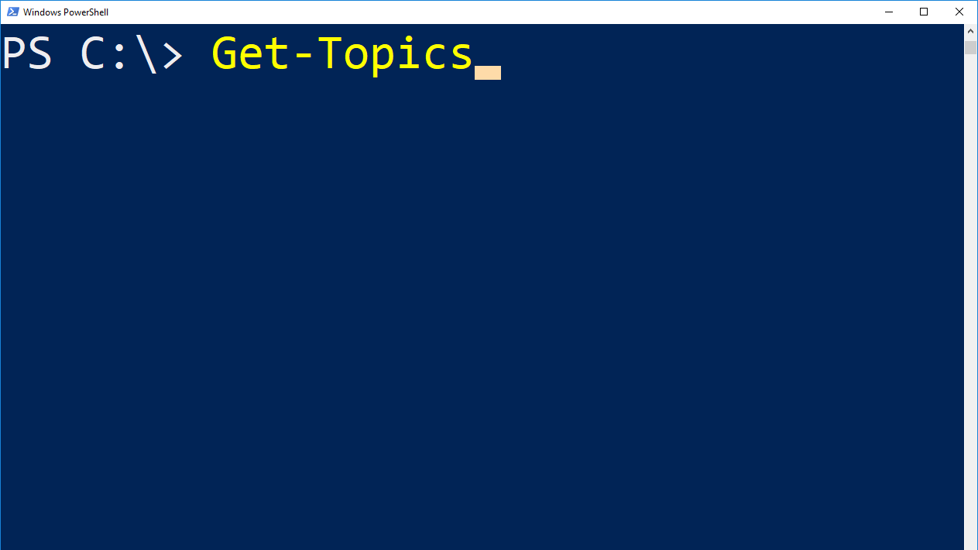
Inline C#
Import DLL in Powershell
Why should i do it?

Slide 4
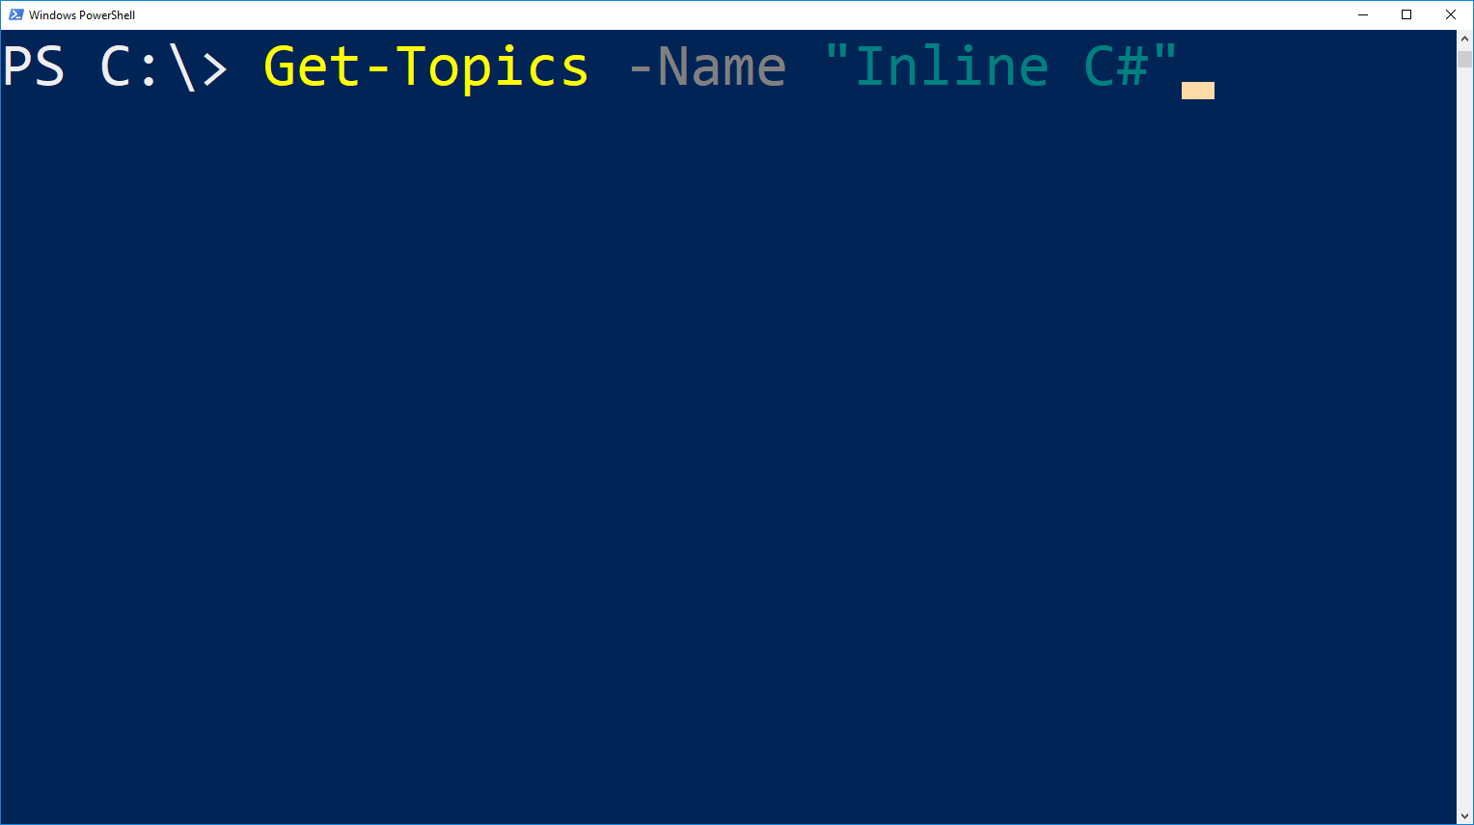
What is Inline C#?
Add C# Code into your Powershell Script/Console
Who does that works?
In memory compilation and execution
how to use?

Slide 5
How to use
$Assem = ( ...add referenced assemblies here... ) $Source = @" //...add C# source code here... "@ Add-Type -ReferencedAssemblies $Assem -TypeDefinition $Source -Language CSharp

Slide 6

Starting Demo….
………
…….
….
Goto Demo Inline C#

Slide 7
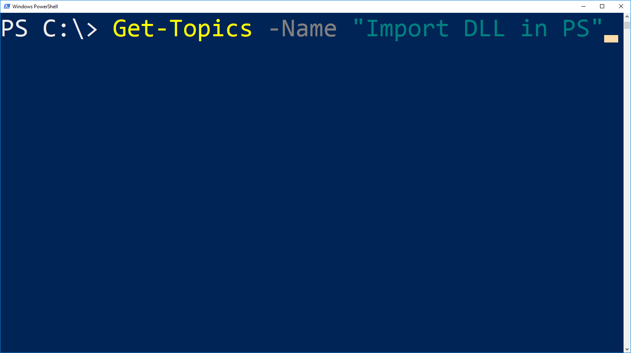
Import DLL in Powershell to use already existing DLLs in Powershell
Use .Net libarys in Powershell
Static vs non Static Methods

Slide 8
#Region Way 1
Add-Type -Path $DLLPath
#Endregion
#Region Way 2
[System.Reflection.Assembly]::LoadFile($DLLPath)
#Endregion
#Region Way 3
$bytes = [System.IO.File]::ReadAllBytes($DLLPath)
[System.Reflection.Assembly]::Load($bytes)
#Endregion

Slide 9

Starting Demo….
………
…….
….
Goto Demo Import DLL in PS

Slide 10
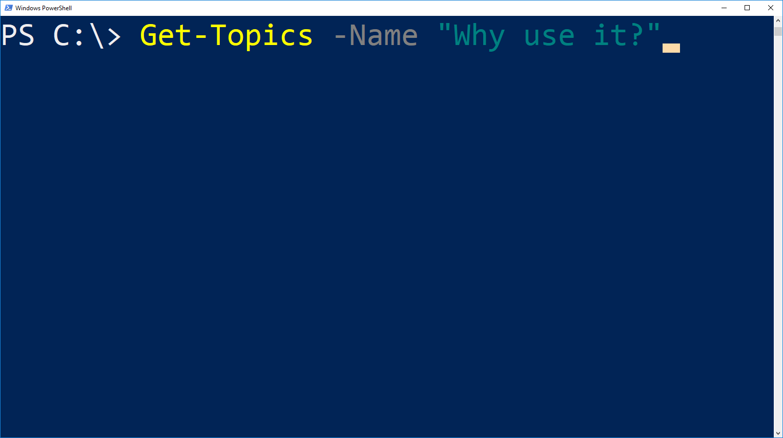
„Legacy“ Code doesnt have to rework
You need the same for both Languages? No Problem…
Performance is in some cases a topic.
Use methods and tasks that are not available in Powershell

Slide 11

Starting Demo….
………
…….
….
Goto Demo Why use it

Slide 12
Good way to enhance Powershell
Good way to use some DLLs that are already exist or written also for C#
Know limitations
Some Language Features does not work.
Like $““ doesnt work (in inline C#)
Allways know about Static/NonStatic

Slide 13
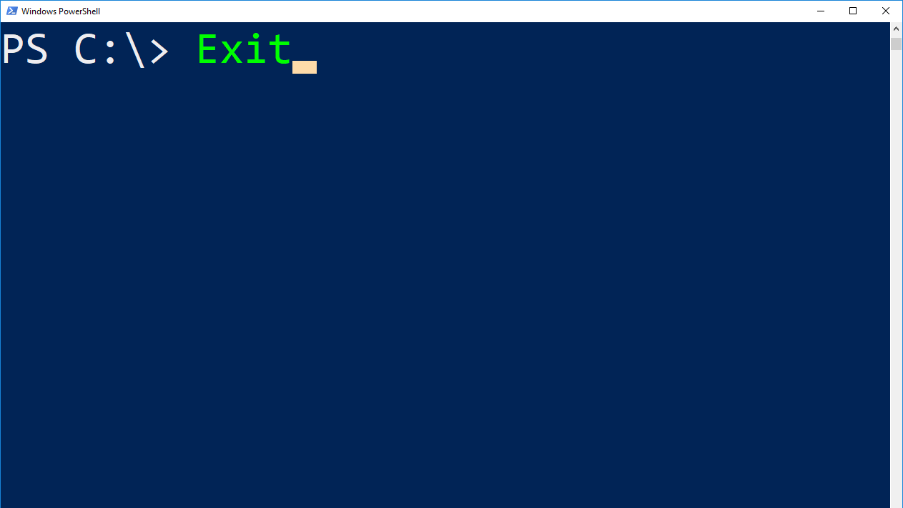
$Questions = Get-Questions -all
If (($Questions).count –gt 0) { $Questions }
Else { Write-Host „Thank you for listening“; Exit; }

